Slide 1
Artificial Intelligence
Matthew Crosby 10170652

Slide 2
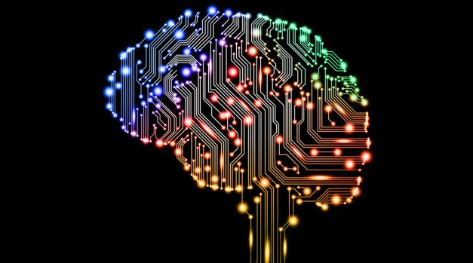
What is Artificial Intelligence
Artificial Intelligence (AI) is the idea of simulating intelligence on a computer system by taking inputted data and trying to perform a task with maximum success.
Fields that use AI include:
Space companies. E.g. Nasa.
Hospitals.
Assembly Lines
(https://www.extremetech.com/wp-content/uploads/2015/09/sat-ai-head-640x353.jpg

Slide 3
How can AI converge with existing technology and how could it potentially replace them.
Many of us have a mobile phone, with some of the most popular running iOS and Android.
These phones include cameras and microphones which can be utilized by software that also has an input of data to create a form of artificial intelligence.
The common AIs on phones include Google Assistant by Google LLC, Bixby by Samsung© and Siri by Apple©
These services use voice input, converting that to text and then searching the web for relevant information.
AI is also changing the way we drive by allowing for driverless cars.
An example of this is Nvidia Drive.
Other ways AI can converge are: Online shopping and music.

Slide 4
How did AI Affect us in the past?
Back in the 1970s AI started making its way into medicine.
AI diagnosed but didn’t give an explanation of how it came to that conclusion so wasn’t trusted.
Clinical Decision Support Systems / CDSSs were used to help doctors make a decision.
A type of this was MYCIN which focused on managing diseases within patients.
Another was QRM which would use a large database of categorized diseases .
QRM was unable to make a full determined diagnostic however.

Slide 5
How AI affects us now
A modern AI system such as the da Vinvi surgical robot could help perform surgery's.
This AI has high precision and accuracy with cutting and stitching.
Some AI like Google’s DeepMind can help to detect more than 50 eye conditions using retinal scans.
Other AI can precisely give a patient the correct amount of treatment based on their records.

Slide 6
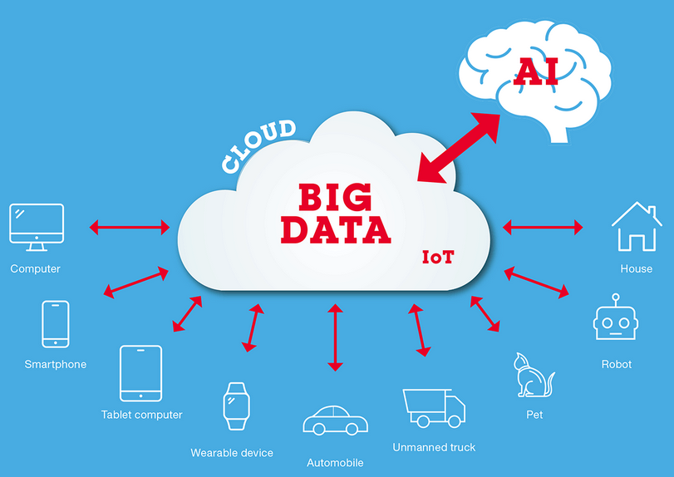
How AI will affect us in the future?
AI could potentially perform full surgeries without human help.
AI could diagnose diseases in their early stages due to trends.
Cures and medicine could be obtained/discovered quicker.
Fully driverless cars without worry.
(http://www.ritsumei.ac.jp/research/radiant/eng/assets/img/robot_ai/story6/radiant-robot_ai-story6-img-04.gif)

Slide 7
How AI influences a specific industry or user group.
AI can be applied to almost any industry no matter how complex the AI might be.
For example, a simple AI that sorts data could be implemented to a records company to help keep the information organized.
A company that would benefit from something like this is the medical industry with patient records.
IBM Watson can take structures and unstructured data to diagnose.
This would grant greater and faster medical services.
Currently the da Vinvi surgical robot is being used to assist surgeons in complex surgery

Slide 8
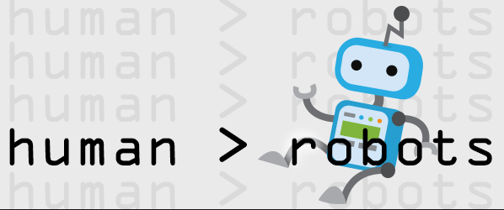
Political factors
AI can reduce human error.
AI will help with the lost costs of the NHS cut of 2018
AI could change current health campaigns aimed at improving the quality of life.
An AI could turn out to be bias.
AI can also be used to help detect any threats that may alter systems such as hacks.
Of example was the ransomware hack on the NHS in 2017
(https://blog-assets.hootsuite.com/wp-content/uploads/2015/03/human_robot600x250.png)

Slide 9
Economic factors
AI is expensive to produce.
AI will cut costs overtime leading to money being spend improving other fields.
AI will improve the amount of time a task would take saving costs.
The same version of AI can be introduced almost anywhere which will also save costs.
Detecting a disease early can save a lot of money that treatment would cost.

Slide 10
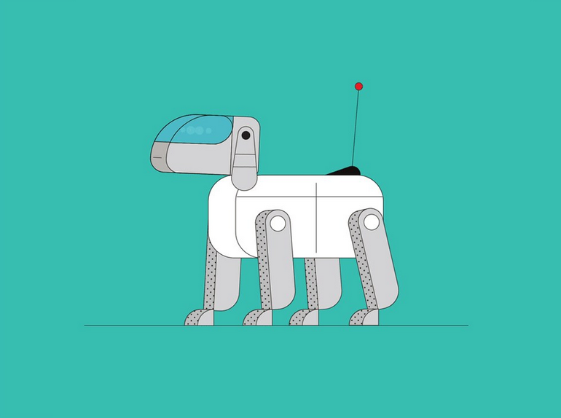
Social factors
Therapeutic animal robots can reduce blood pressure, reduce anxiety and help with social skills.
Eliminate human fatigue.
Data can be processed and faster by AI
No chance of getting distracted.
Can improve quality of life.
(https://media.wired.com/photos/5a72ad9dd8520d1deb145f61/master/pass/Guides_AI.jpg)

Slide 11
Advantages of AI
AI can deal with tedious tasks.
This allows for people to focus on more creative tasks.
AI can make extremely fast decisions.
AI can help with exploration in places such as space, or the ocean.
AI can help/improve our daily lives. Such as Alexa or Google Assistant.
AI can learn of data we give it.

Slide 12
Benefits of AI
Patients can get diagnosed quicker saving money.
Can perform the same task over and over the exact same way.
The money saved from AI can help improve other areas.
AI can help people in the jobs they perform.
In the U.K productivity has increased by 25% thanks to AI.
AI is upgradable in every way.

Slide 13
Features of AI
Machine learning.
Deep learning. - This is possible thanks to 2.6 quintillion bytes of data every day being produced.
Ability to spot trends. E.g. popular Netflix shows.
Has natural language processing and understanding to speak in multiple languages.

Slide 14
Disadvantages of AI
High cost to create and maintain if the AI breaks.
The AI could get hacked. E.g. an AI saving lives could be hacked to do the opposite.
AI doesn’t have imagination or creativity.
Can cause unemployment.

